Slide 1
Why Assistive Technology? Nancy Maldonado

Slide 2
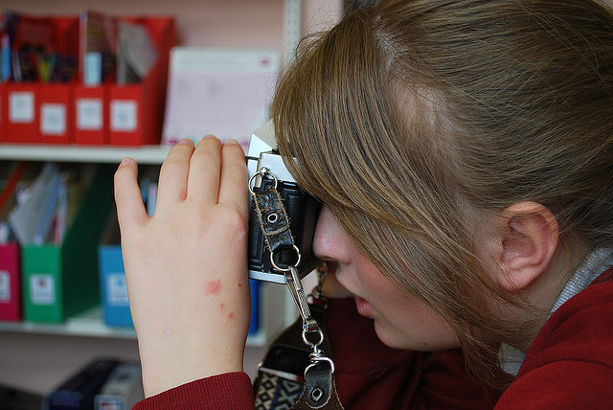
What are they?
Notes:
Slide 2: They are tools that make academic material more accessible student learning or educational supervisors assessing teacher effectiveness
In other words, assistive technology give students with communication disabilities a voice and a way to live more fulfilled, integrated and independent lives inside and outside of class.

Slide 3
Fullfills special needs
Notes:
-Vision impairment
-Hearing impairment
-Speech or language impairment
-Cognitive Challenges
-Learning disability

Slide 4
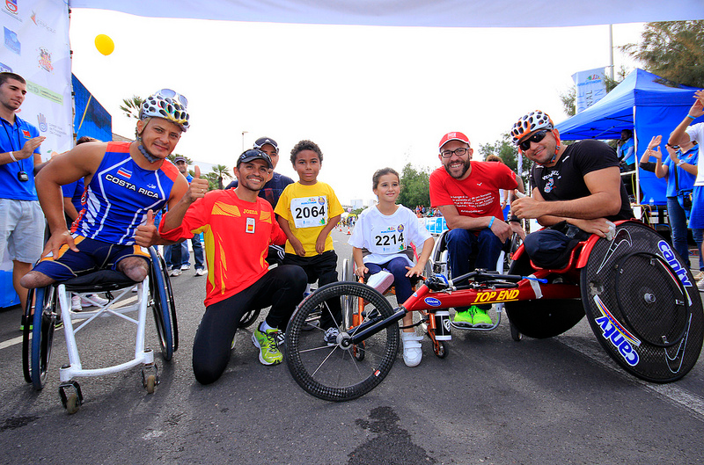
Why?
Notes:
-Promotes self-esteem
-Improves quality of life
-Increases productivity
-Enhances performances
-Increases independence in classroom

Slide 5
Technologies
Notes:
Computers
Screen reading software
Smartphones
Voice recognitions
Podcasts

Slide 6
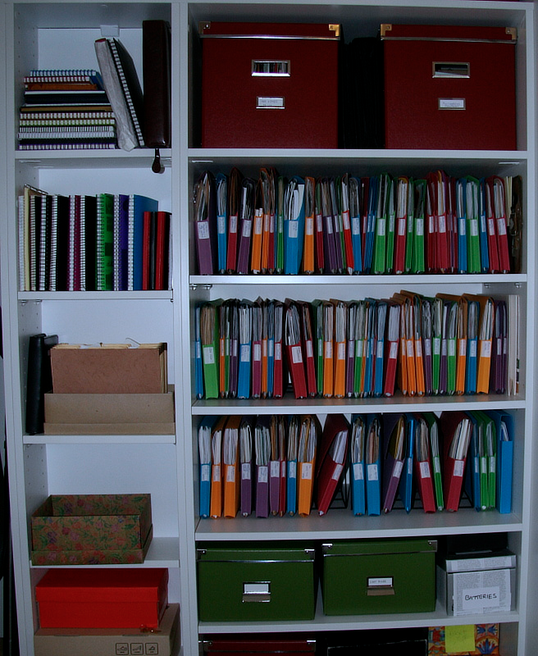
Background
Notes:
Step 1: Collect child information. Begin the discussion about the child’s strength, abilities, preferences, and needs. What works best?
Step 2: Find activities for participation. During this time, observe what is preventing the student from participating in a particular activity.
Step 3: What can be observed that indicates the intervention is successful?
Step 4: Try it out! Look for what worked, didn’t work. What can be done differently? Make Modifications.

Slide 7
http://www.youtube.com/watch?v=IcUNnnwFm4g

Slide 8
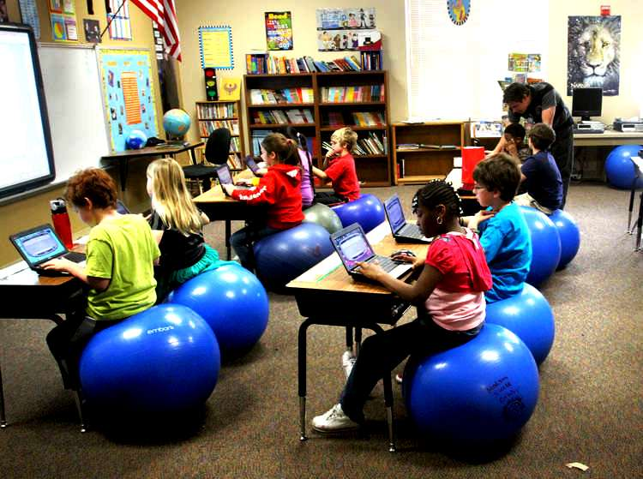
Teachers
Notes:
The use of assistive technology in the classroom affects teaching and learning on many positive levels. Through the use of technology, teachers not only have ability to address and attend to a students’ specific needs for learning but also enables teachers to instruct students with disabilities successfully
Also- Develops inclusive lesson plans
Monitors progress

Slide 9
New World
Notes:
Opens up a new world of learning for students with disabilities by providing an enriched environment to promote their social and cognitive participation and growth.

Slide 10
Resources
Photo credit to:
- Blue Square Thing
- Lanzarote Marathon
- Katie Lepi
http://www.mycutegraphics.com/graphics/reading/boy-listening-to-book-cd-player.html
http://elluminateled.com/aboutleds.html

